Slide 1
Magnetic properties of superconductors
Section 53

Slide 2
The fundamental characteristic of superconductors is the Meissner Effect, which is the exclusion of magnetic induction B from the volume of superconductor.
Always true, since there is no magnetic charge
is continuous at boundary of superconductor
inside superconductor by Meissner Effect
B is everywhere tangential to the surface of a superconductor

Slide 3
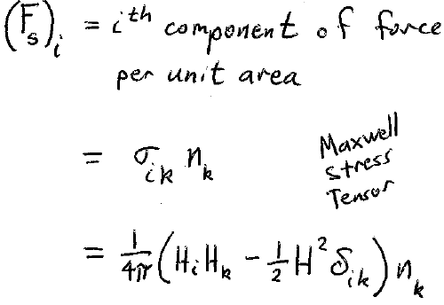
Forces on a superconductor

Slide 4
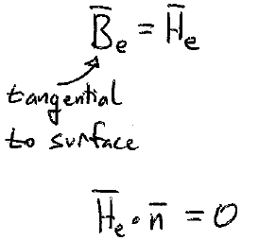
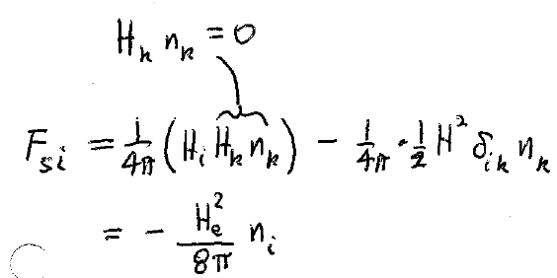
Magnetic field in the vacuum outside of a superconductor

Slide 5
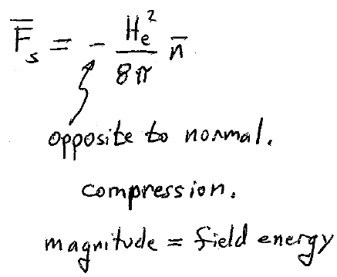
Compare to electrostatic force on conductors!

Slide 6
A superconductor has no macroscopic volume currents inside, because of Meissner effect.
Includes conduction and magnetization currents
= 0,
since B = 0 inside.
Mean current density

Slide 7
One cannot isolate the conduction and magnetization current contributions within
We cannot define M as for normal conductors according to
when
on any cross section.
M and H have no physical significance in superconductors.

Slide 8
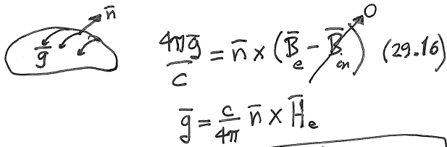
All electric current in superconductor is surface current.
Surface current is determined by H-field outside a superconductor

Slide 9
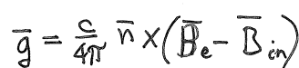




Non-superconducting magnetized bodies also have surface currents
For a normal conductor
is continuous
This equation restricts the possible value of the current based on B_{in}.
For a normal magnetized material , surface current is determined by B-field inside, which arises from the magnetization.

Slide 10
For non-superconducting magnetized body, the surface currents for any cross section always balance out to zero.
Singly connected body
Doubly connected body

Slide 11

For superconductor, we can have non-zero total current on the surface.
Even though H has no physical meaning inside, it need not be zero.
Continuity of H_{t} still holds.
In super state B -> 0 implies μ = B/H -> 0 simultaneously.
Then is indeterminate.
Does not restrict values of current.
Total current through any cross section need not be zero in a superconductor.

Slide 12
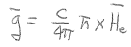
is determined by the field outside the superconductor, not by any field inside.
Net current can exist without an E-field applied to the superconductor.
That means the electrical resistance = 0
And there is no dissipation of energy j.E = 0.
The complete absence of electrical resistance is a consequence of the Meissner Effect

Slide 13
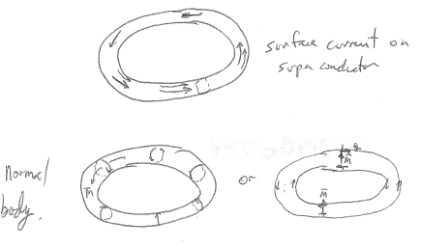
Magnetized normal body also has a surface current, but it is restricted so that the net current through any cross section is zero.

Slide 14
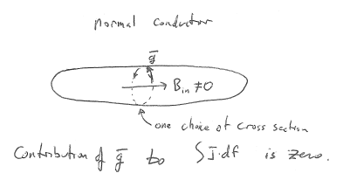

Slide 15
